Slide 1


Bank of Baroda Hackathon - 2022
Technology Partner
Team Name :Nerds
Your team bio : ECE Students of St Josephs College of Engineering
Date :11th September 2022

Slide 2
Problem Statement?
Why did you decide to solve this Problem statement?
As it is seen that Banks have played a vital portion in the day to day life of stakeholders such as industrialists,traders and common public like pensioners and many more.Inspite of the netbanking services,there are some works which needs to be carried out in bank’s premises. Banks have been inevitable part of thier life.
They often tend to look up to banks without any hesitation for any monetary services. So it is very important to not only satisfy them but assist them by using the exixting potential resources to help the banks evolve technically.
Video analytics is such a budding domain which is efficient and laborsaving. Thereby implementing the cognition would help the bank’s progress and facilitates the customers.
The cameras used here not only can be put to security purposes but can be extended to asses the employess efficiency which is a direct indicator of customer satisfaction.

Slide 3
User Segment & Pain Points
Our solution can be put to use in places like Banks ,markets ,jewellery shops etc.As our product involves segments like:
Person count
Camera tampering
Emotion recognition
Less time delay
More efficient
Time taken for each service
Frequency of a customer

Slide 4
Pre-Requisite
Adoption of opencv with the help of python for counting the number of people and face recognition for analysing the sentiments of the people which is made in feedback for reducing the error.
Using the video footage for analysing the count of people on normal days and special occasions which helps in predicting the requirements.
Tampering cameras is more common today so our idea is employ a small camera near to the main cctv which can be made activated when the cctv gets tampered.

Slide 5
Alternatives/competitive products for the problems we are going to solve:
The CCTV camera used is exclusively for security purposes but here we employ camera for other important parameters like emotion capturing , track on number of people.
This type of solution is not physically existing anywhere till date except for a hypothesis.
Hence introduction to our solution in market has a high scope.

Slide 6
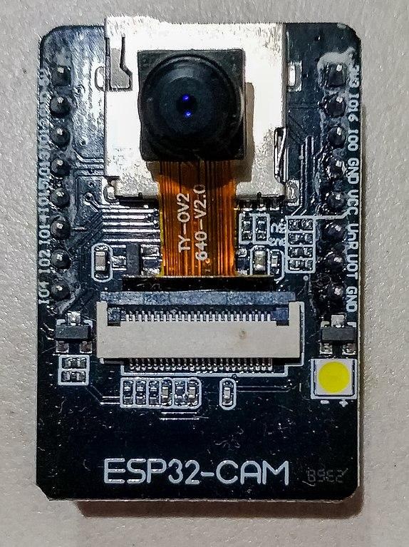
Azure tools or resources which are used by us for the prototype:
ESP 32 cam
ESP32-CAM can be widely used in various IoT applications.
It is suitable for home smart devices, industrial wireless control, wireless monitoring, QR wireless identification, wireless positioning system signals and other IoT applications.
It is an ideal solution for our prototype.

Slide 7

GITHUB
1.Github is an open-source version control platform. It allows programmers to work on projects together and share their code quickly whenever necessary.
2.In this project we are going to use the github for the base code of the project and we will proceed by modifying it.

Slide 8
Process Involved:
Collect images from Esp32-cam to create a dataset
Using python artificial intelligence/machine learning algorithms via opencv for image recognition.
Using the image processing techniques for further analysis.
Deploying the classifier for Esp32-cam for real-time image recognition.
Keep track on the duration of activity for an each individual.
Keep count on number of people coming at different time periods thereby predicting number of people and make the services ready.
Frequency of a customer is also regularly tracked.

Slide 9

Any Supporting Functional Documents

Slide 10
Key Differentiators & Adoption Plan
Our alternative is cheap and efficient.
Our solution is easily accessible and can be easily modified
Avoiding tampering with the help of two cameras is one of the key differentiators in our project
The product can be easily adopted since it uses the feedback mechanisms and sources in the product can be easily modified

Slide 11
GitHub Repository Link & supporting diagrams, screenshots, if any
Github links
https://github.com/aakashjhawar/face-recognition-using-deep-learning
https://github.com/saimj7/People-Counting-in-Real-Time
https://github.com/girpinto/Emotion_Detection_Python#emotion-detection-in-python
https://github.com/atulapra/Emotion-detection

Slide 12
Thank You
An intiative by:
Dennis Reo Joseph R
Vaddi Sri Rama Gayathri
Saiyoogeswaran D
Sivayogarajan L

